Slide 1
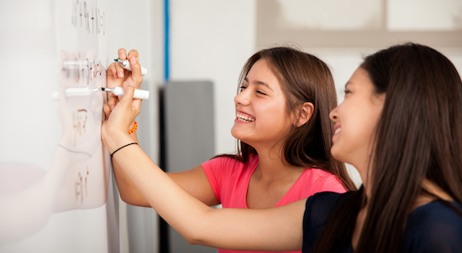
Problem Solving Session
The remainder of today’s class will comprise the problem solving session (PSS).
Your instructor will divide you into teams of 3 or 4 students.
Each team will work together to solve the following problems over the course of 20-30 minutes.
You may work on paper, a white board, or digitally as determined by your instructor.
You will submit your solution by pushing it to GitHub before the end of class.
Your instructor will go over the solution before the end of class.
If there is any time remaining, you will begin work on your homework assignment.
Class participation is a significant part of your grade (20%). This includes in class activities and the problem solving session.
Your Course Assistants will grade your participation by verifying that you pushed your solutions before the end of the class period each day.

Slide 2
Problem Solving 1
Def next_row():
turtle.right(90)
turtle.forward(PIXEL_SIZE)
turtle.left(90)
Write a function that will move the turtle from its current location so that it is positioned to begin drawing pixels in the next row.
pixart.next_row()

Slide 3
Problem Solving 2
Def sequence_pixel():
pixelno = 0
while pixelno<8:
pixart.draw_pixel(color)
pixelno += 1
Def Main():
pixart.draw_pixel(red)
Main()
Write a function that uses a while loop to draw sequence of red pixels. The number of pixels should be provided as an argument.
pixart.red_pixels(8)

Slide 4
Problem Solving 3
Def palindrome():
Write a function that returns True if a string is a palindrome, and False otherwise. Consider at least the cases in the table below.
Input | Result
"" (empty string) | True
"a" | True
"aa" | True
"ab" | False
"abcba" | True
"abcab" | False

Slide 5
Problem Solving 4
Def red_and_black()
number = 0
while number > 0
if red
Write a function that, given a number of columns, draws that number of pixels alternating between red and black.
pixart.red_and_black(7)

Slide 6
Problem Solving 5
def draw_pixel():
num = 0
while num < len(colortonum):
if character = “0”:
draw_pixel(“black”)
elif character == “1”:
draw_pixel(“White”)
elif character == “2”:
draw_pixel(“red”)
Assume that your pixart module includes a function for each of the colors in the table below. Write a function that, given a string of digits, will draw a sequence of pixels of the corresponding colors, e.g.
pixart.draw_pixels('34402')
Input | Color String | Color
0 | 'black'
1 | 'white'
2 | 'red'
3 | 'yellow'
4 | 'orange'

